Slide 1
Distributed Secheduling Service(DSS)
2020.10.30

Slide 2
Summary of DSS

Slide 3
Summary of DSS
The DSS aims to provide a unified and common task Scheduling Service for business systems, provide a management platform for scheduled tasks, reduce the workload of business system development and subsequent online operation and maintenance, and improve the performance of large data tasks through task splitting and load balancing. Functions and Objectives:
Unified schedule task registration and management platform
Centralized scheduling, message notifications
Improve the performance of large data task by task splitting
Support for special periods (downtime maintenance)
Provide convenient test support
Notes:
分布式调度服务（Distributed Scheduling Service）旨在为业务系统提供统一通用的任务调度服务，提供定时任务的管理平台，减轻业务系统开发和后续线上运维的工作量，并通过任务拆分和负载均衡等方案提升大数据量任务的性能。功能和目标：
统一的定时任务注册和管理平台
集中的定时调度、消息通知
通过任务拆分提升大数据量任务的性能
特殊时段（停机维护）的支持
提供便捷的测试支持

Slide 4
The principle of DSS

Slide 5
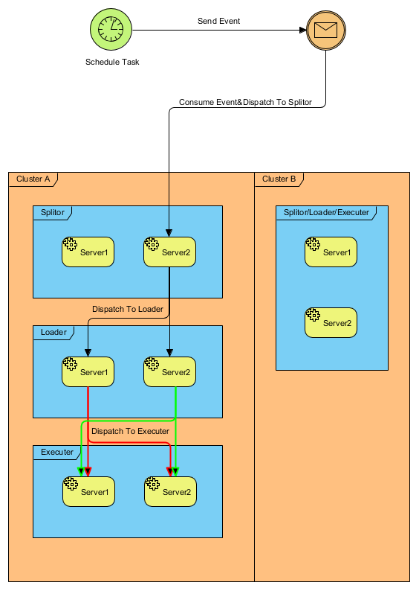
The principle of DSS
The DSS timing task relies on "Distributed Message Service DMS" implementation. The DSS server sends a DMS message to the application at the time of task execution according to the timed task information configured by the user. After the application receives the DMS message, it begins to perform the three-tier distribution logic(load balance)
Notes:
DSS 定时任务依赖于 “分布式消息服务 DMS”实现。DSS 服务端按照用户配置的定时任务信息，到了任务执行时间就向应用发送一个 DMS 消息。应用接收到 DMS 消息后，开始执行三层分发逻辑（复杂均衡）。

Slide 6
The Usage of DSS

Slide 7
The Usage of DSS
<dependency> <groupId>com.alipay.sofa.platform</groupId> <artifactId>sofa-platform-schedule</artifactId> <version>4.1.2</version> </dependency>
Reference schedule dependency in POM
configurate Schedule Task in XML
Write classes to implement the Splitor,Loader,Executor interfaces
<!-- 注册任务参数 --> <sofa:extension bean="taskManager" point="param"> <sofa:content> <param> <groupId>S-integrationprod-scheduler</groupId> </param> </sofa:content> </sofa:extension> <sofa:extension bean="taskManager" point="task"> <sofa:content> <task name="EC_SPECIFIC_MERCHANT_QUERY_TASK"> <splitor>specificMerchantQueryDssHandler</splitor> <loader>specificMerchantQueryDssHandler</loader> <executer>specificMerchantQueryDssHandler</executer> </task> </sofa:content> </sofa:extension>
public class SpecificMerchantQueryDssHandler implements Splitor, Loader, Executer { @Override public void execute(String businessKey) { } @Override public List<String> load(DataLoadFilterItem dataLoadFilterItem) { return Collections.emptyList(); } @Override public List<DataLoadFilterItem> split() { return Collections.emptyList(); }
Notes:
1.pom引用schedule依赖
2.进行schedule task的xml配置
3.编写自定义类实现Splitor,Loader,Executor接口

Slide 8
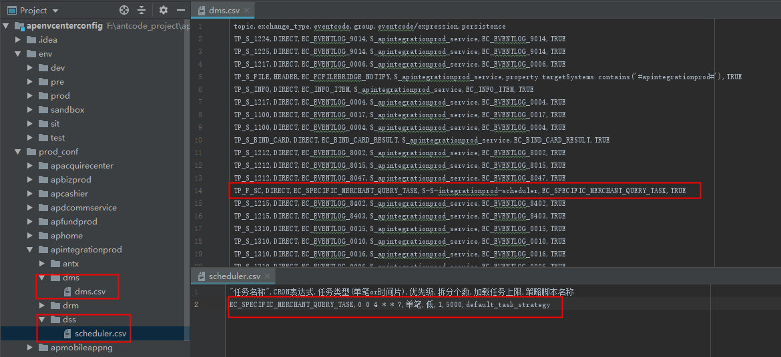
The Usage of DSS
Configure schedule task in DSS files
Configure messages sent by schedule tasks in DMS files
Notes:
通过dss文件配置定时
通过dms文件配置定时任务发出的消息

Slide 9
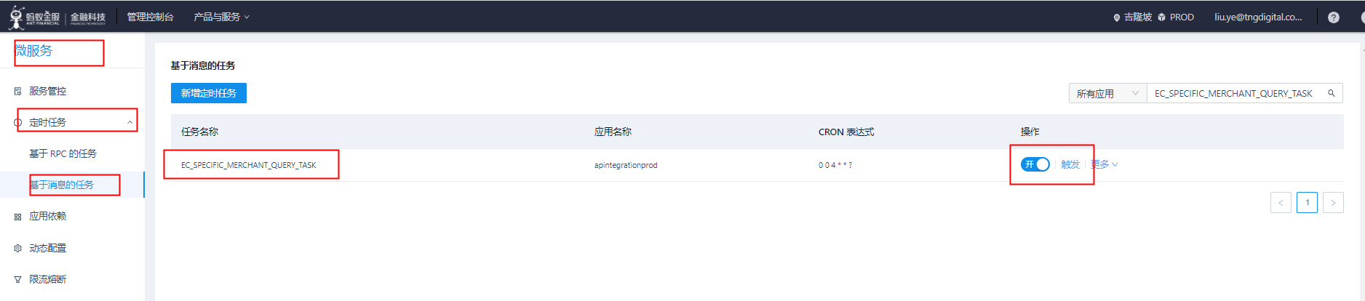
The Usage of DSS
After the release, the financial cloud micro-service platform can see the corresponding schedule task. If the DSS file is not configured, it can also be configured in the financial cloud, but currently it is usually configured in the DSS file.
In the financial cloud platform, the schedule task can be modified, manually triggered, switched and other operations
Notes:
发布后金融云微服务平台可以看到对应定时任务，dss文件不配置的话，也可以在金融云加，但是目前统一在dss文件配置.
在金融云平台可以对定时任务进行修改，手动触发，开关等操作

Slide 10

Thank you

